Slide 1

Team Details
Scholar Sphere:An E-Learning Platform
Minor Project - 01
Team-27
Guide –Prof. Vijaylaxmi S.
NAME | USN | ROLL NO
Kshitij Singh | 01FE21BCS305 | 552
Arman Khan | 01FE21BCI037 | 154
Manoj S Kulkarni | 01FE21BCS097 | 520
Gayatri Shenvi | 01FE21BCI062 | 152

Slide 2

Sustainable Development Goals
The Sustainable Development Goals (SDGs), also known as the Global Goals, were adopted by the United Nations in 2015 as a universal call to action to end poverty, protect the planet, and ensure that by 2030 all people enjoy peace and prosperity.

Slide 3

Problem Statement
To provide accessible and inclusive education, our E-learning platform offers free education to empower learners from diverse backgrounds. We aim to promote skill development and lifelong learning, in line with Sustainable Development Goal 4.

Slide 4
Functionalities mapped to Quality Education
Free Access to Quality Education Resources: Our website provides free access to educational resources such as courses and books, aligning with the goal of ensuring equitable access to quality education.
User Registration and Profile Management: Enabling student registration promotes inclusivity and lifelong learning, regardless of geographical or socio-economic constraints.
Course Enrollment: Students can enroll in various courses offered on our platform, ensuring that they have the opportunity to complete primary and secondary education regardless of physical barriers.
Mentor-led Course Creation: Mentors can create and manage courses on our platform, contributing to the diversity and relevance of educational content available to students.
Gender Equality: By providing equal access to educational resources for all students, regardless of gender, our website contributes to gender equality in education, as outlined in SDG 4.5.

Slide 5
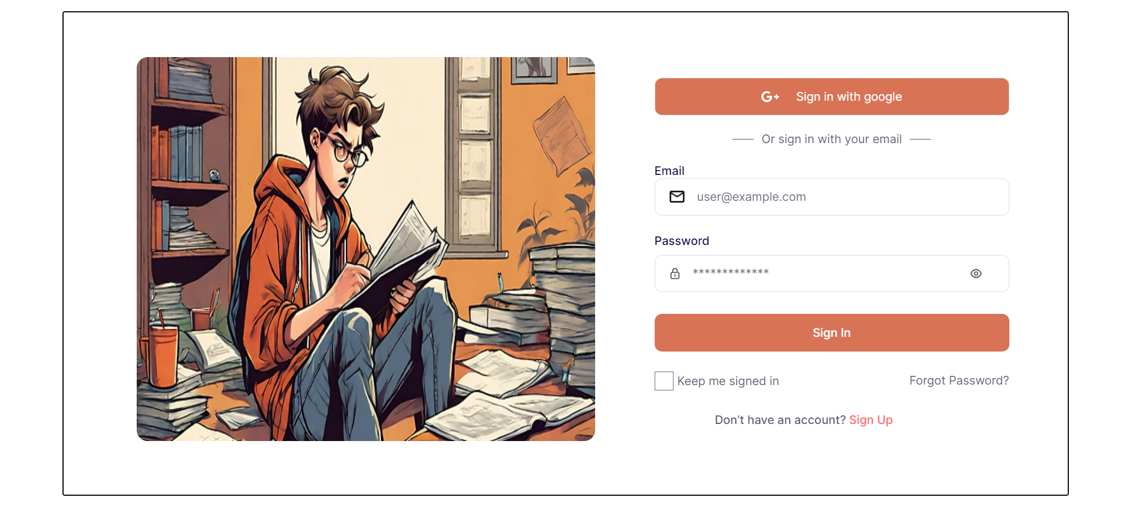
User Interface using React

